Slide 1
Trends Impacting Cloud Adoption now
Cost optimization (+)
Multicloud strategies (+)
Insufficient cloud IaaS skills (-)

Slide 2
Cost optimization
IaaS - selecting the most cost-effective architecture that can deliver the required performance
third-party cost optimization tools - higher-quality analytics
maximize savings without compromising performance
provide independence from cloud providers
offer multicloud management consistency

Slide 3
Multicloud strategies
Reduce vendor lock-in (dependency)
Application portability is the ability to migrate an application across platforms without change

Slide 4
Insufficient cloud IaaS skills
Delays migrations to the cloud
Service providers cannot train and certify people quickly enough to satisfy the need for skilled cloud professionals

Slide 5
IaaS adoption
IaaS
Benefits
- Shift focus from IT management to core activities
- No IT infrastructure management costs
- Pay-per-use/pay-per-go pricing
- Guaranteed performance
- Dynamic scaling
- Secure access
- Enterprise grade infrastructure
- Green IT adoption
Characteristics
- Multi-tenancy
- Virtualized hardware
- Management & monitoring tools
- Disaster recovery
Adoption
- Individual users: Low - Small & medium enterprises: Medium - Large organizations: High
- Government: High
Examples
- Amazon Elastic Compute Cloud (EC2)
- RackSpace
- GoGrid
- Eucalyptus
- Joyent
- Terremark
- OpSource
- Savvis
- Nimbula
- Enamoly

Slide 6
PaaS adoption
PaaS
Benefits
- Lower upfront & operations costs
- No IT infrastructure management costs
- Improved scalability
- Higher performance
- Secured access
- Quick & easy development
- Seamless integration
Characteristics
- Multi-tenancy
- Open integration protocols
- App development tools & SDKs
- Analytics
Adoption
- Individual users: Low - Small & medium enterprises: Medium - Large organizations: High
- Government: Medium
Examples
- Google App Engine
- Windows Azure Platform
- Force.com
- RightScale
- Heroku
- Github
- Gigaspaces
- AppScale
- OpenStack
- LongJump

Slide 7
SaaS adoption
SaaS
Benefits
- Lower costs
- No infrastructure required
- Seamless upgrades
- Guaranteed performance
- Automated backups
- Easy data recovery
- Secure
- High adoption
- On-the move access
Characteristics
- Multi-tenancy
- On-demand software
- Open integration protocols
- Social network integration
Adoption
- Individual users: High - Small & medium enterprises: High - Large organizations: High
- Government: Medium
Examples
- Google Apps
- Salesforce.com
- Facebook
- Zoho
- Dropbox
- Taleo
- Microsoft Office 365
- Linkedin
- Slideshare
- CareCloud

Slide 8
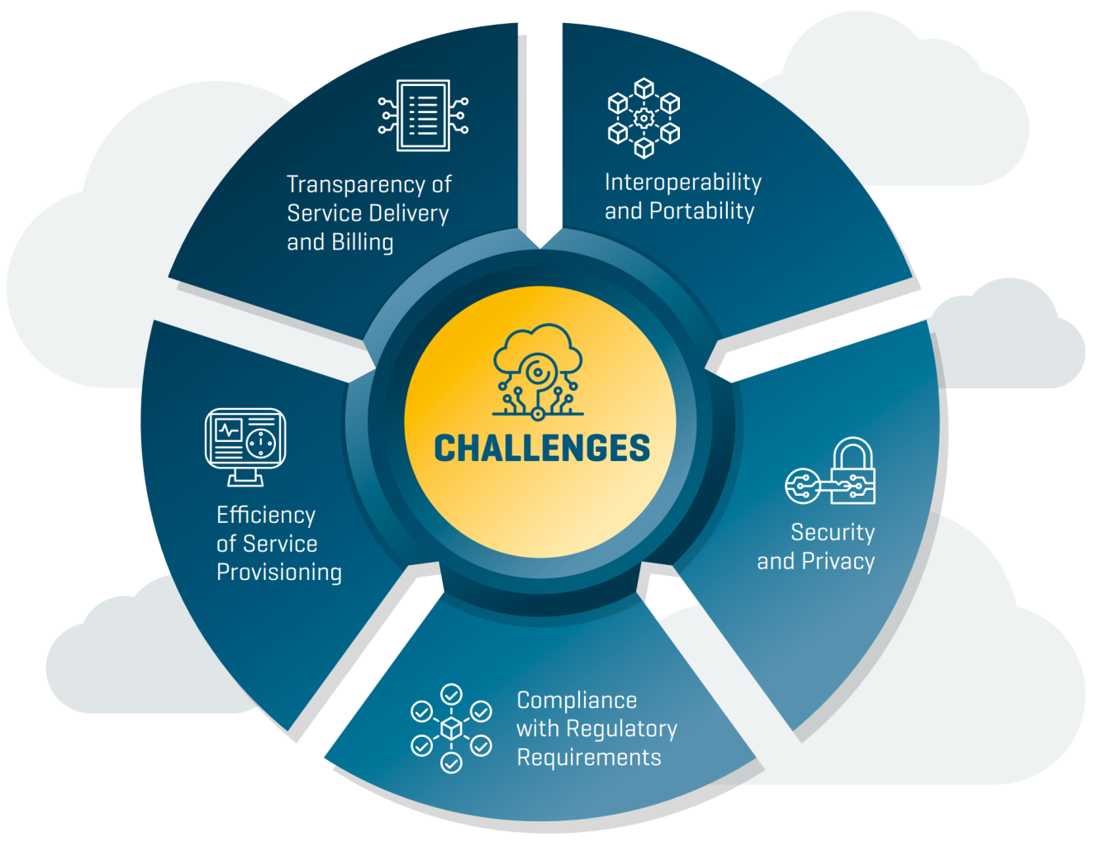
Challenges in the adoption of Cloud Computing

Slide 9
Solutions
Cloud Computing challenges have resulted in extensive studies and the emergence of relevant technical standards.
Many standards bodies have approached appropriate standards in different areas of Cloud Computing in order to assess, manage risks and contribute in the development of this technology in a holistic manner, as it has become a crucial element in the ICT sector
We have introduced some these standards in our previous lectures

Slide 10
Cloud Computing Standardization and Reference Architecture
Standardization of cloud computing
Cloud Computing Reference Architecture
Cloud computing standards and laws in China
Cloud computing adoption issues

Slide 11
Summary (1)
Standardization of cloud computing
Standards ensure that goods or services produced in a specific industry come with consistent quality
Many standards and specifications related to Cloud Computing have been developed by standards developing organizations
Foundational standards that deal with vocabulary and reference architecture are essential for developing other standards

Slide 12
Summary (2)
Cloud Computing Reference Architecture
Cloud Computing Reference standard defines the basic building blocks—architectural elements and their relationships—which make up the cloud
Cloud computing reference models were proposed by multiple cloud organizations and standard setting bodies
ISO/IEC 17789:2014, Cloud computing – Reference architecture is a standard developed by ISO that contains diagrams and descriptions of how various aspects of cloud computing relate to one another and includes cloud computing roles, activities and functional components and their relationships.

Slide 13
Summary (3)
Cloud computing standards and laws in China
China has developed a number of standards and laws that regulate the adoption of cloud computing technology in different aspects (security, privacy, financial and others)
Chinese parties collaborate with international standard setting bodies

Slide 14
Summary (4)
Cloud computing adoption issues
Different parties (people, businesses, countries, …) adopt cloud computing at a different rate
There are still many challenges impacting cloud adoption
Standards contribute to the adoption of cloud by addressing some of these challenges

